Slide 1
Main Memory
Course Instructor: Safia Baloch

Slide 2
Background
Program must be brought (from disk) into memory and placed within a process for it to be run
Main memory and registers are only storage, CPU can access directly
Memory unit only sees a stream of addresses + read requests, or address + data and write requests
Register access in one CPU clock (or less)
Main memory can take many cycles, causing a stall
Cache sits between main memory and CPU registers
Protection of memory required to ensure correct operation

Slide 3
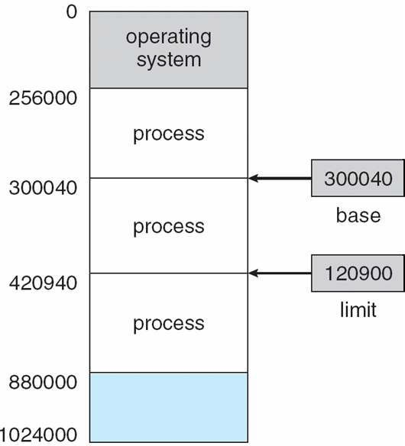
Base and Limit Registers:Memory Protection
A pair of base and limit registers define the logical address space for a process
CPU must check every memory access generated in user mode to be sure it is between base and limit for that user

Slide 4

Hardware Address Protection with Base and Limit Registers

Slide 5
Address Binding
Programs on disk, ready to be brought into memory to execute form an input queue
Without support, must be loaded into address 0000
Inconvenient to have first user process physical address always at 0000
Because most of the time, system processes are allocated in this range.
Further, addresses represented in different ways at different stages of a program’s life
Source code addresses usually symbolic:variables
Compiled code addresses bind to relocatable addresses
Linker or loader will bind relocatable addresses to absolute addresses
Each binding maps one address space to another

Slide 6
Binding of Instructions and Data to Memory
Address binding of instructions and data to memory addresses can happen at three different stages
Compile time: If memory location known a priori, absolute code can be generated; must recompile code if starting location changes
Load time: Must generate relocatable code if memory location is not known at compile time
Execution time: Binding delayed until run time if the process can be moved during its execution from one memory segment to another and here
Need hardware support for address maps (e.g., base and limit registers)

Slide 7
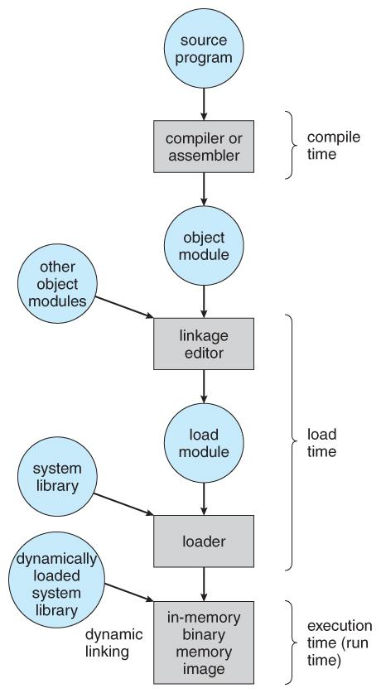
Multistep Processing of a User Program

Slide 8
Logical vs. Physical Address Space
The concept of a logical address space that is bound to a separate
1)Logical address – generated by the CPU; also referred to as virtual address
2)Physical address – address seen by the memory unit
Logical and physical addresses are the same in compile-time and load-time address-binding schemes; logical (virtual) and physical addresses differ in execution-time address-binding scheme
Logical address space is the set of all logical addresses generated by a program
Physical address space is the set of all physical addresses generated by a program

Slide 9
Memory-Management Unit (MMU)
MMU is a hardware device that at run time maps virtual address to physical address
To start, consider simple scheme where the value in the relocation register is added to every address generated by a user process at the time it is sent to memory
Base register now called relocation register
MS-DOS on Intel 80x86 used 4 relocation registers
The user program deals with logical addresses; it never sees the real physical addresses
Execution-time binding occurs when reference is made to location in memory

Slide 10
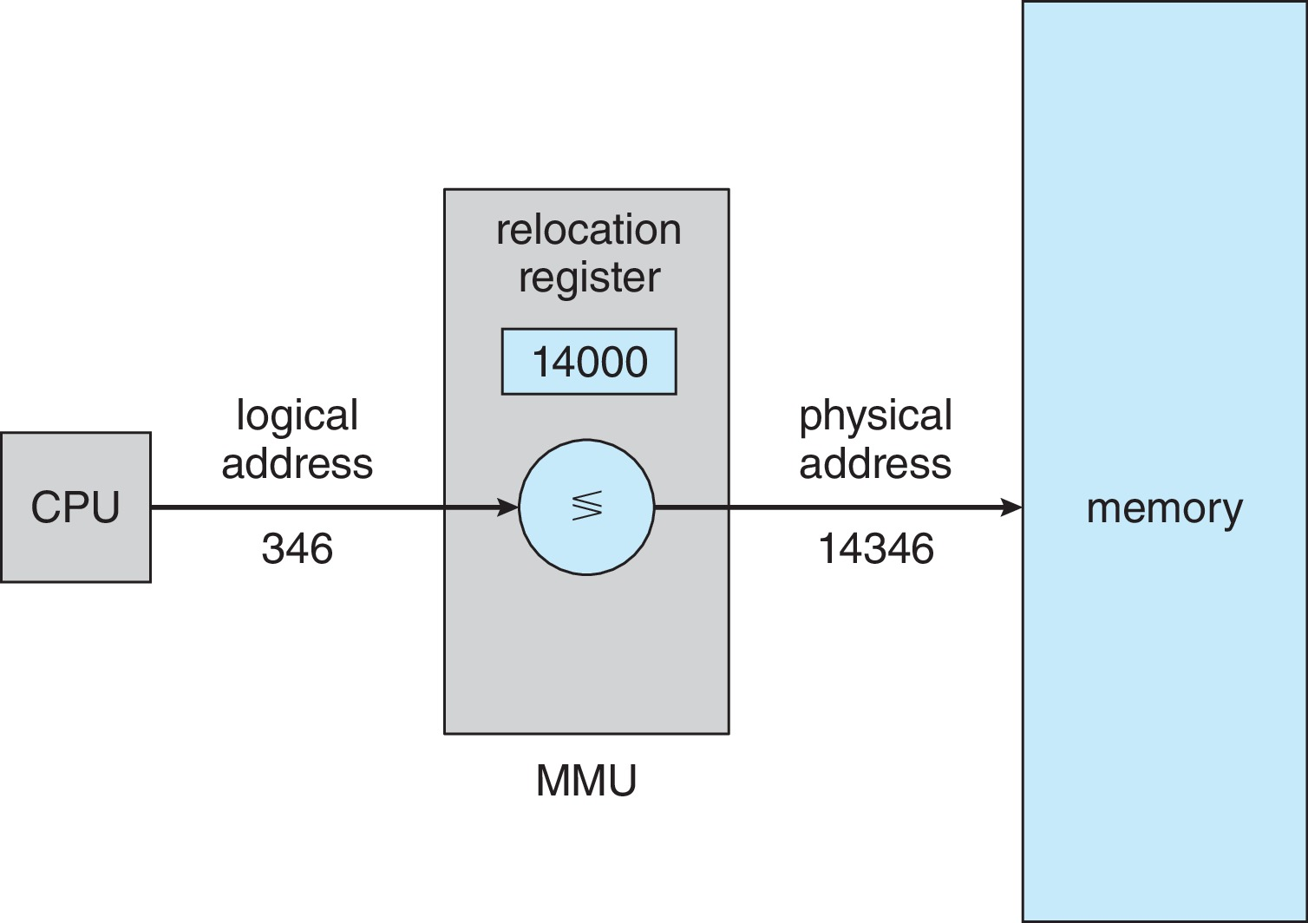
Dynamic relocation using a relocation register
Routine is not loaded until it is called
Better memory-space utilization; unused routine is never loaded
All routines kept on disk in relocatable load format
Useful when large amounts of code are needed to handle infrequently occurring cases
No special support from the operating system is required
Implemented through program design
OS can help by providing libraries to implement dynamic loading

Slide 11
Static &Dynamic Linking
Static linking – system libraries and program code combined by the loader into the binary program image
Dynamic linking –linking postponed until execution time
Small piece of code, stub, used to locate the appropriate memory-resident library routine
Stub replaces itself with the address of the routine, and executes the routine
Dynamic linking is particularly useful for libraries

Slide 12
Swapping [1/2]
A process can be swapped temporarily out of memory to a backing store, and then brought back into memory for continued execution
Backing store – fast disk large enough to accommodate copies of all memory images for all users; must provide direct access to these memory images
Roll out, roll in – swapping variant used for priority-based scheduling algorithms; lower-priority process is swapped out so higher-priority process can be loaded and executed
Major part of swap time is transfer time; total transfer time is directly proportional to the amount of memory swapped

Slide 13
Swapping [2/2]
System maintains a ready queue of ready-to-run processes which have memory images on disk
Does the swapped out process need to swap back in to same physical addresses?
Depends on address binding method
Plus consider pending I/O to / from process memory space
Modified versions of swapping are found on many systems (i.e., UNIX, Linux, and Windows)
Swapping normally disabled
Started if more than threshold amount of memory allocated
Disabled again once memory demand reduced below threshold

Slide 14
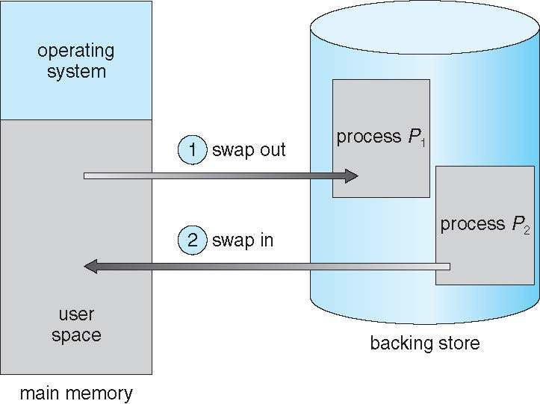
Schematic View of Standard Swapping

Slide 15
Context Switch Time including Swapping [1/2]
If next processes to be put on CPU is not in memory, need to swap out a process and swap in target process
Context switch time can then be very high
Swap in Time= size of (process) / transfer rate
100MB process swapping to hard disk with transfer rate of 50MB/sec = 2 sec or 2000msec.
Swap out time = 2000 ms
Plus swap in of same sized process
Total context switch swapping time (Swap In +out) =4000ms (4 seconds)

Slide 16
Contiguous Allocation(not contagious;it was only to wake you up)
Main memory must support both OS and user processes
Limited resource, must allocate efficiently
Contiguous allocation is one early method
Main memory usually into two partitions:
Resident operating system, usually held in low memory with interrupt vector
User processes then held in high memory
Each process contained in single contiguous section of memory

Slide 17
Contiguous Allocation (Cont.)
Relocation registers used to protect user processes from each other, and from changing operating-system code and data
Base register contains value of smallest physical address
Limit register contains range of logical addresses – each logical address must be less than the limit register
MMU maps logical address dynamically
Can then allow actions such as kernel code being transient and kernel changing size

Slide 18
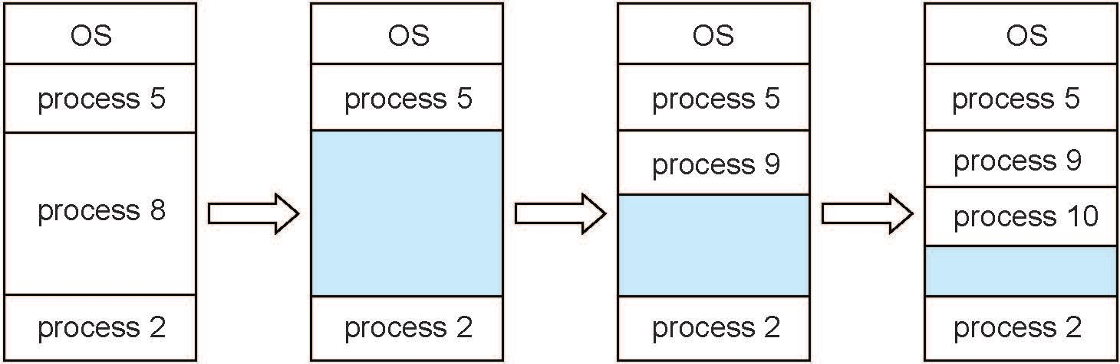
Multiple-partition allocation
Multiple-partition allocation
Degree of multiprogramming limited by number of partitions
Variable-partition sizes for efficiency (sized to a given process’ needs)
Hole – block of available memory; holes of various size are scattered throughout memory
When a process arrives, it is allocated memory from a hole large enough to accommodate it
Process exiting frees its partition, adjacent free partitions combined
Operating system maintains information about: a) allocated partitions b) free partitions (hole)

Slide 19
Dynamic Storage-Allocation Problem
How to satisfy a request of size n from a list of free holes?
First-fit: Allocate the first hole that is big enough
Best-fit: Allocate the smallest hole that is big enough; must search entire list, unless ordered by size
Produces the smallest leftover hole
Worst-fit: Allocate the largest hole; must also search entire list
Produces the largest leftover hole
First-fit and best-fit better than worst-fit in terms of speed and storage utilization

Slide 20
Fragmentation
External Fragmentation – total memory space exists to satisfy a request, but it is not contiguous
Internal Fragmentation – allocated memory may be slightly larger than requested memory; this size difference is memory internal to a partition, but not being used
First fit analysis reveals that given N blocks allocated, 0.5 N blocks lost to fragmentation
1/3 may be unusable -> 50-percent rule

Slide 21
Paging
Physical address space of a process can be noncontiguous; process is allocated physical memory whenever the latter is available
Avoids external fragmentation
Avoids problem of varying sized memory chunks
Divide physical memory into fixed-sized blocks called frames
Size is power of 2, between 512 bytes and 16 Mbytes
Divide logical memory into blocks of same size called pages
Keep track of all free frames
To run a program of size N pages, need to find N free frames and load program
Set up a page table to translate logical to physical addresses
Backing store likewise split into pages
Still have Internal fragmentation: How?

Slide 22
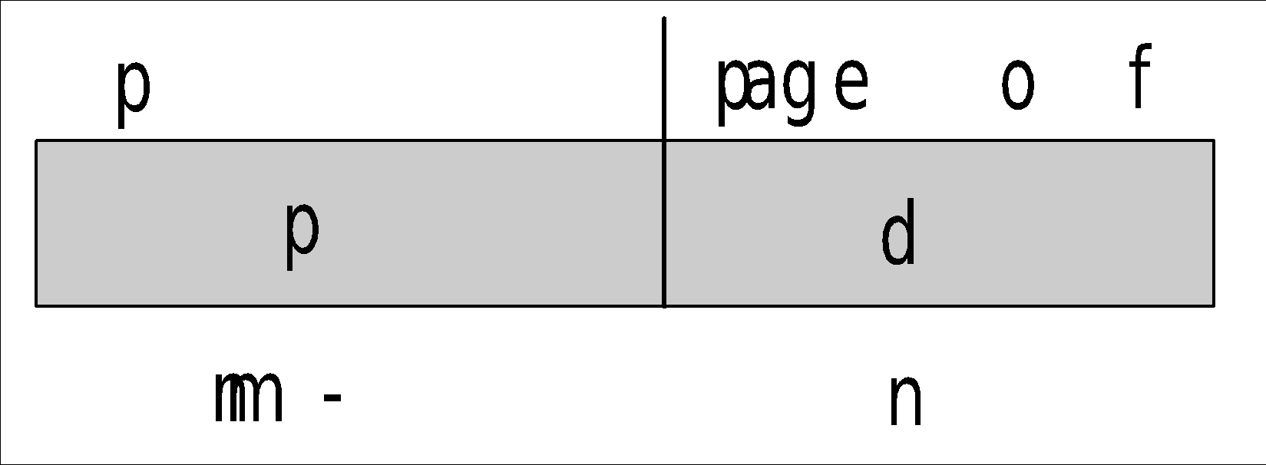
Address Translation Scheme
Address generated by CPU is divided into:
Page number (p) – used as an index into a page table which contains base address of each page in physical memory
Page offset (d) – combined with base address to define the physical memory address that is sent to the memory unit
For given logical address space 2^{m} and page size 2^{n}

Slide 23
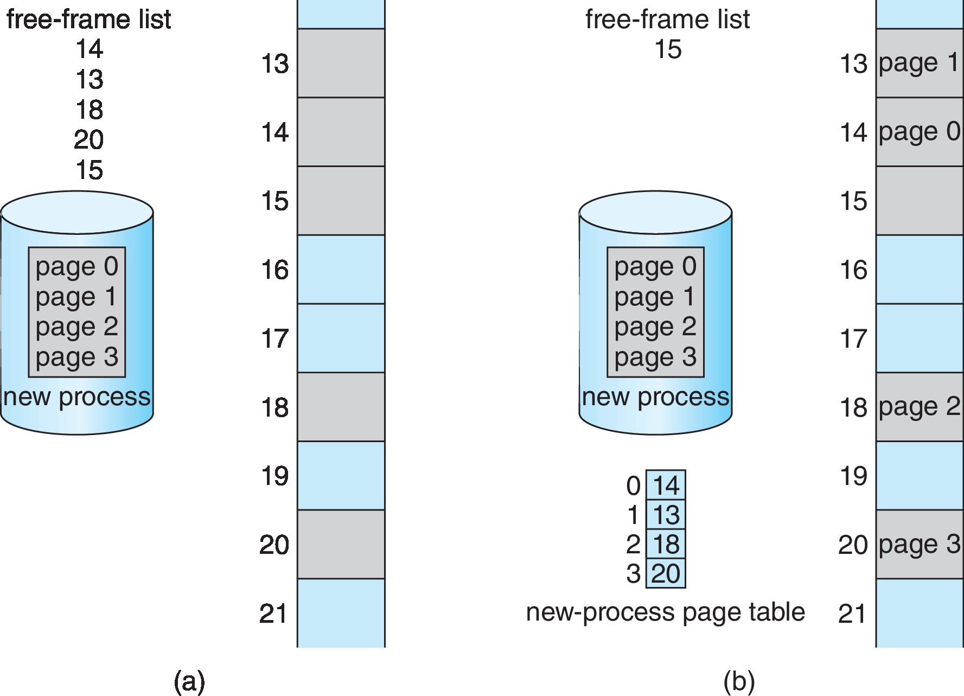
Paging Model of Logical and Physical Memory
Notes:
Free frames (a) before allocation and (b) after allocation

Slide 24
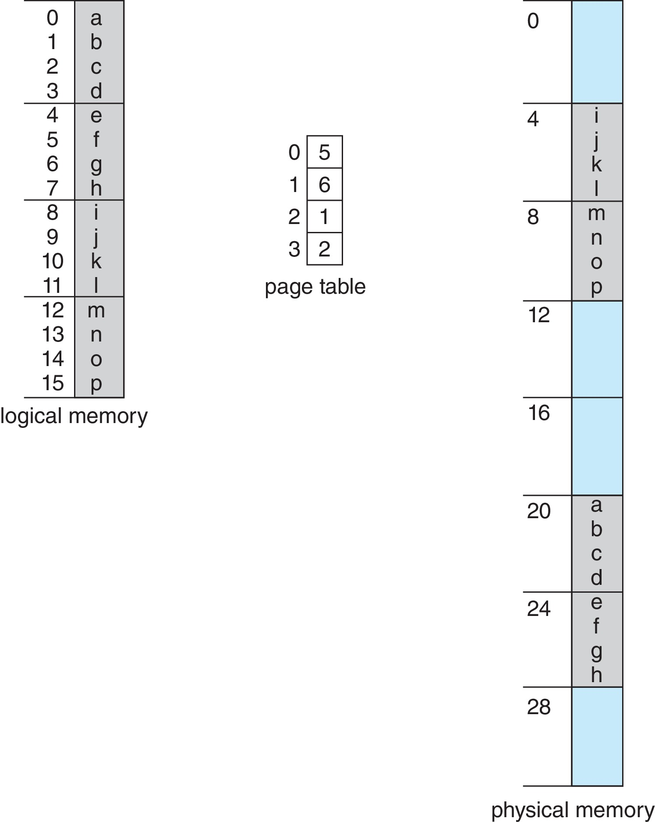
Paging Example
The page size is 2^2 = 4,
the size of the logical memory is 2^4 bytes = 16 bytes, and
the size of the physical memory is 2^5 bytes = 32 bytes.
The page table maps logical page 0 to physical frame 5, and so on.

Slide 25
Brain Buster
Internal fragmentation can be avoided (not completely) with small size of page or large size of page?
Advantage of large size of page?
Frames can be non contiguous but page must be ,WHY?
For logical/physical address in bits we do m+n, for bits in a page we do?
Notes:
A small page size reduces internal fragmentation.
A large page size keeps the page table smaller and reduces the total amount of I/O overhead for copying pages to and from the backing store.
Memory protection, to check base and limit, we need a contiguous range of logical or page.
Total pages for logical address/ page size= 2^m/2^n= 2^m.2^-n= 2^(m-n)

Slide 26
Implementation of Page Table
Page table is kept in main memory
Page-table base register (PTBR) points to the page table
Page-table length register (PTLR) indicates size of the page table
In this scheme every data/instruction access requires two memory accesses
One for the page table and one for the data / instruction
The two memory access problem can be solved by the use of a special fast-lookup hardware cache called associative memory or translation look-aside buffers (TLBs)
TLB Hit or Miss

Slide 27
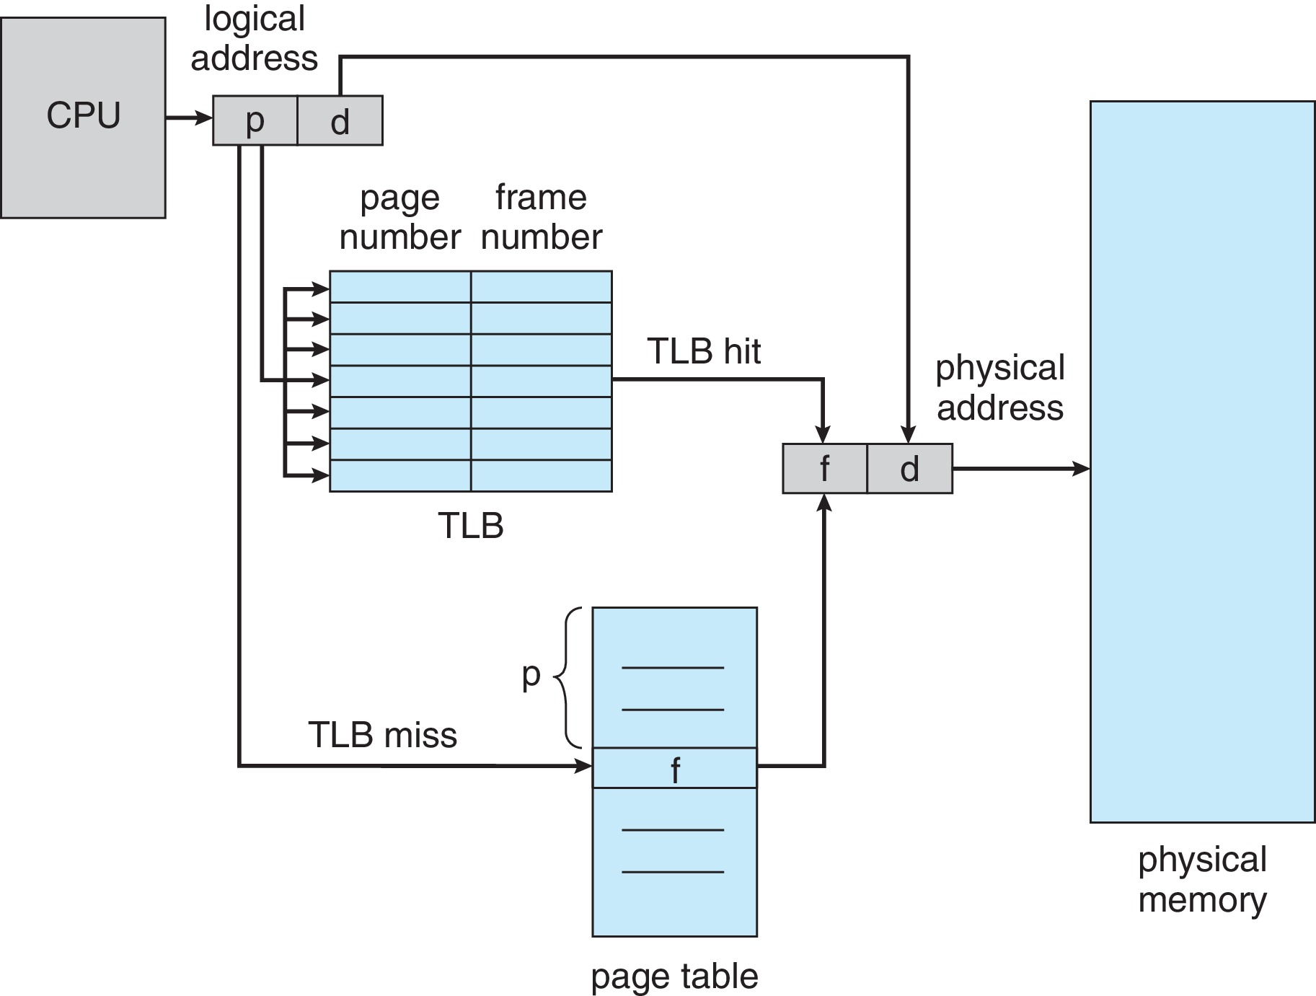

Slide 28
Effective memory Access Time:EAT
Effective memory access time (EAT) is a function of the hit ratio, memory access time, and TLB search time.
For example, if the hit ratio is 90% and the memory access time is 12 nanoseconds, then, according to our simple model, the EAT would be calculated as (0.9)(12)+(0.1)(24) = 13.2 ns.

Slide 29
Paging: Hardware support
Storing the page table in main memory result in slower memory access time. Solution TLB
TLB: each entry in consist of 1) Key, 2) value
Search item with all keys, if found then returned value of it.
TLB Hit,
TLB Miss
TLB full of entries?

Slide 30
Replacement policies
In case of TLB full with entries, existing pages are replaced with current one with help of different algorithms. LRU, Round Robin , second chance etc.
Wired Down entries in TLB: Kernel entries
ASIDs: address space identifier to uniquely identify each process.
In-case of virtual page number, it helps to resolve, and help TLB to have several different process entries simultaneously.

Slide 31
Paging: Hardware support
Protection bit: Associate a bit to protect from illegal attempts of physical address (frames)
Valid_invalid bit: if page is in logical address space then bit is valid else invalid.
Shared Pages: process sharing common code: c library etc
40 user, 2 MB of libc

Slide 32
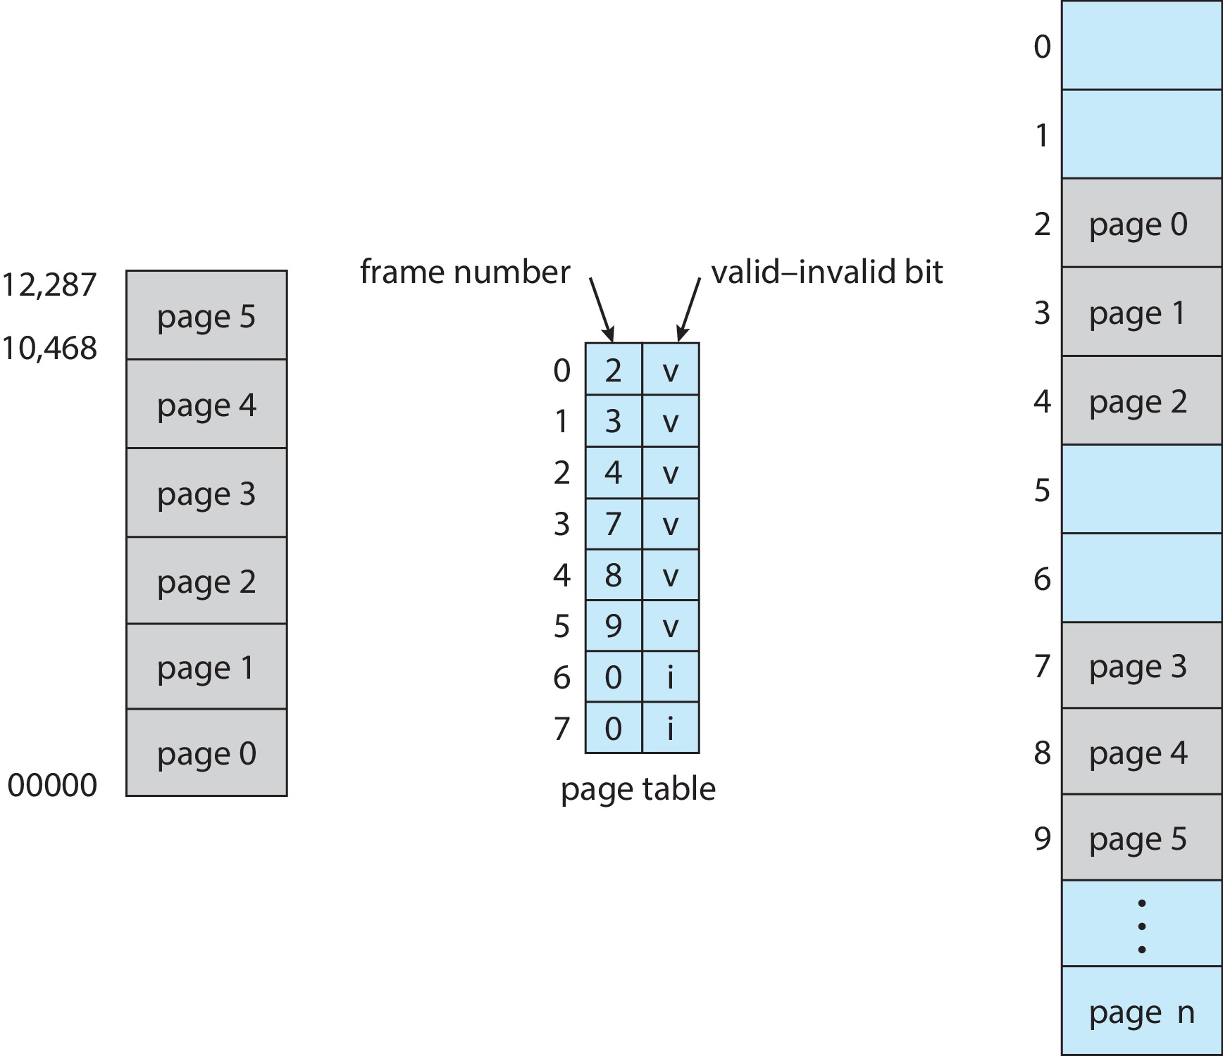
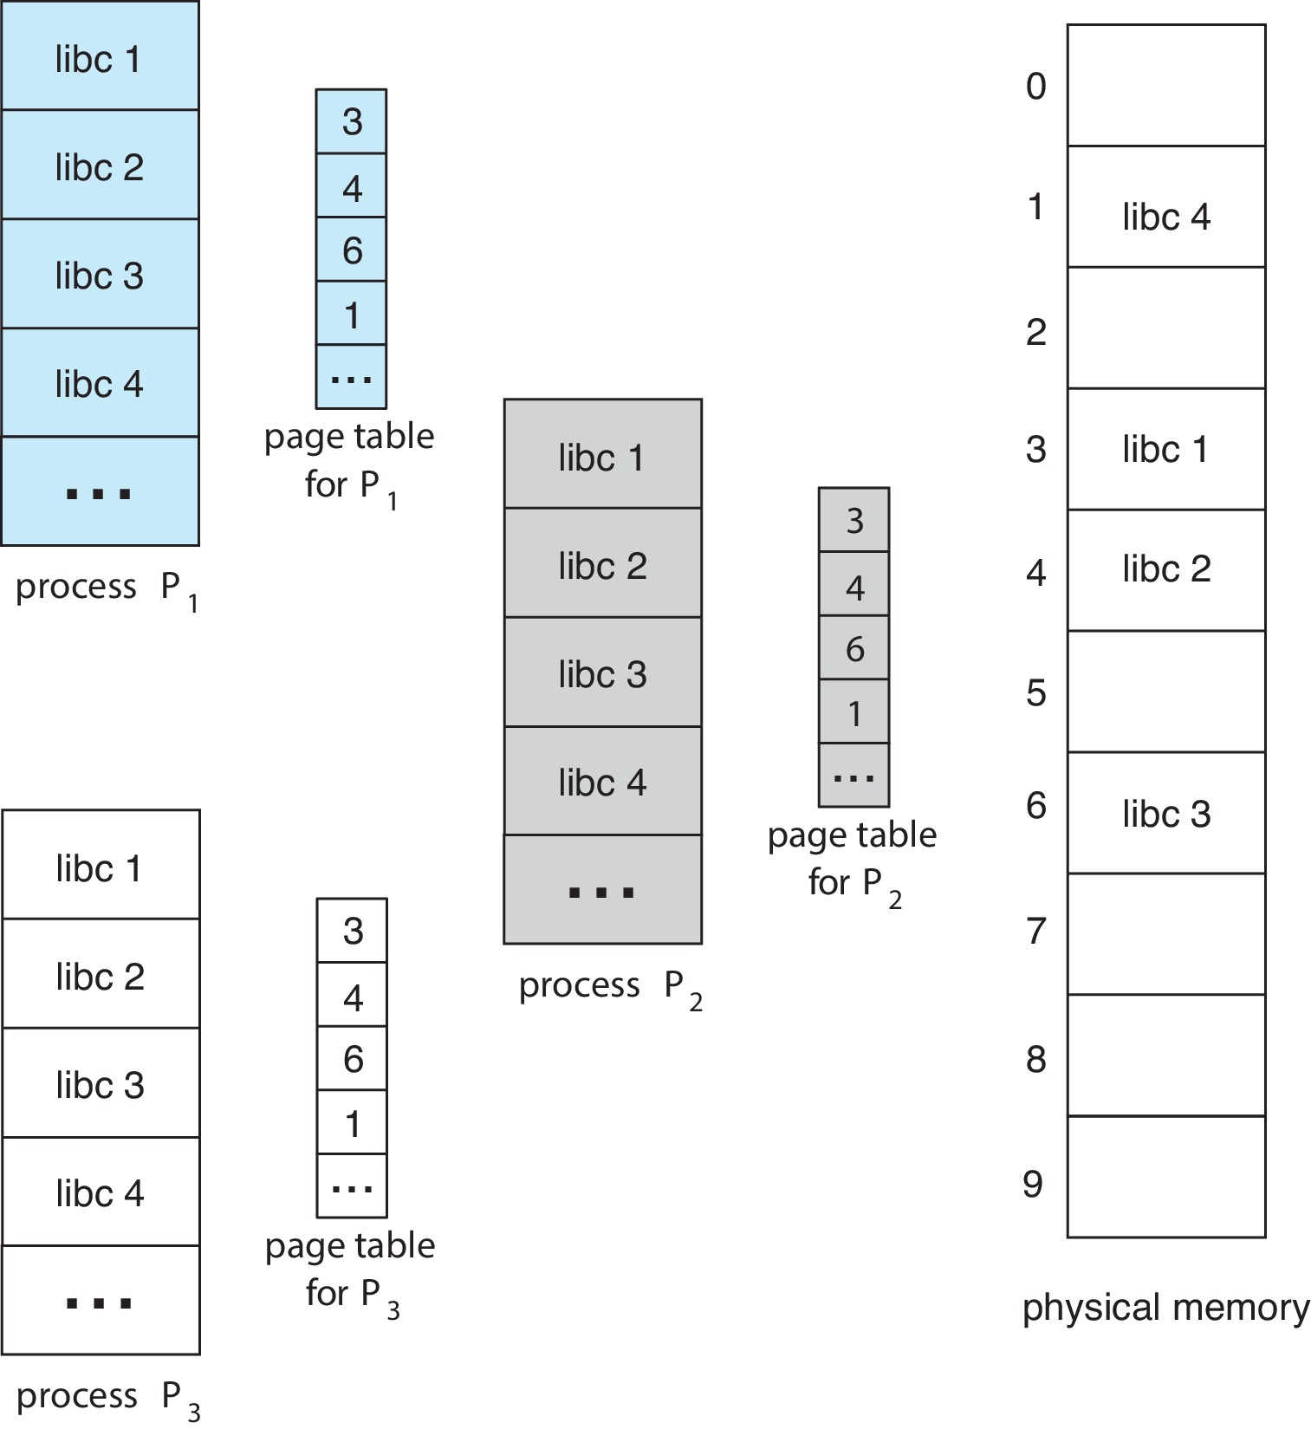

Slide 33
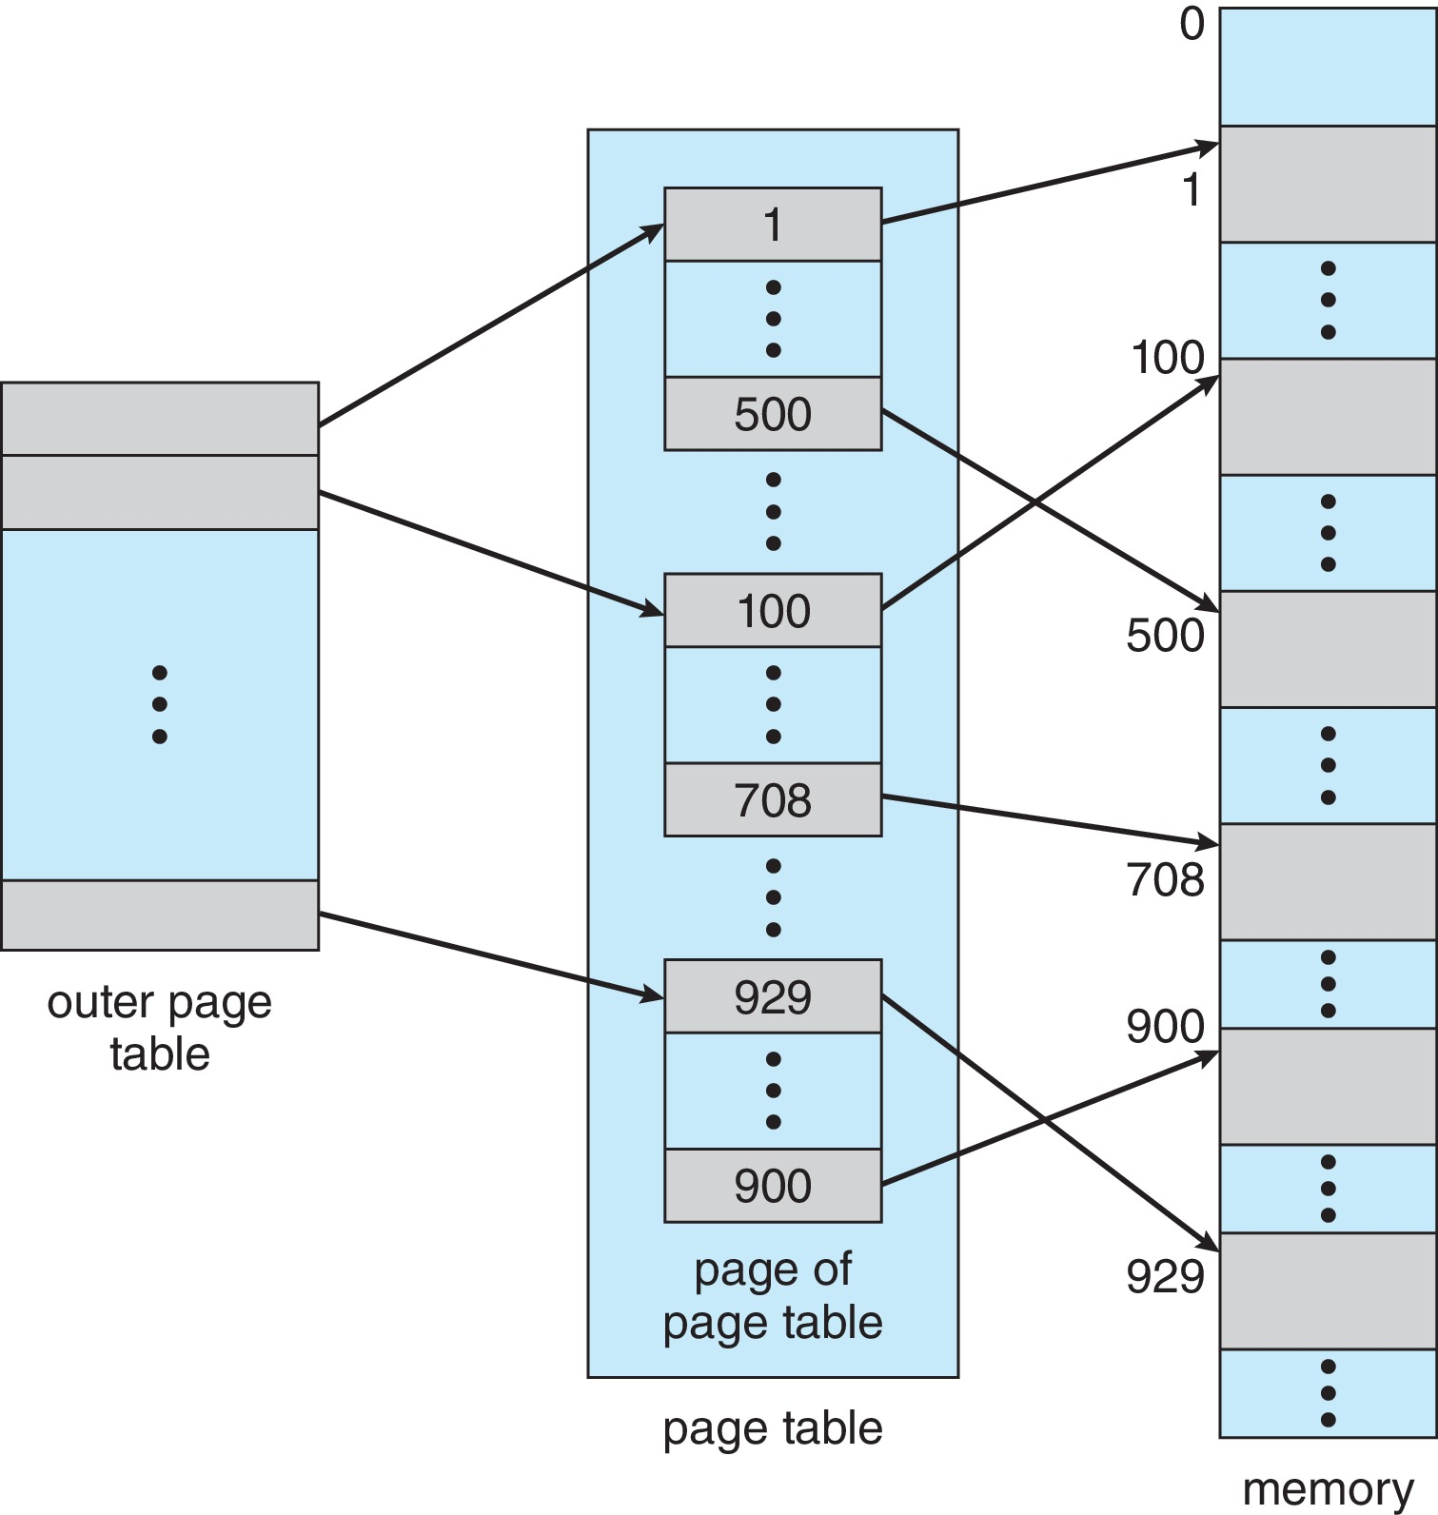
Structure of
Page Table
Hierarchical Paging:
Page the page table:

Slide 34
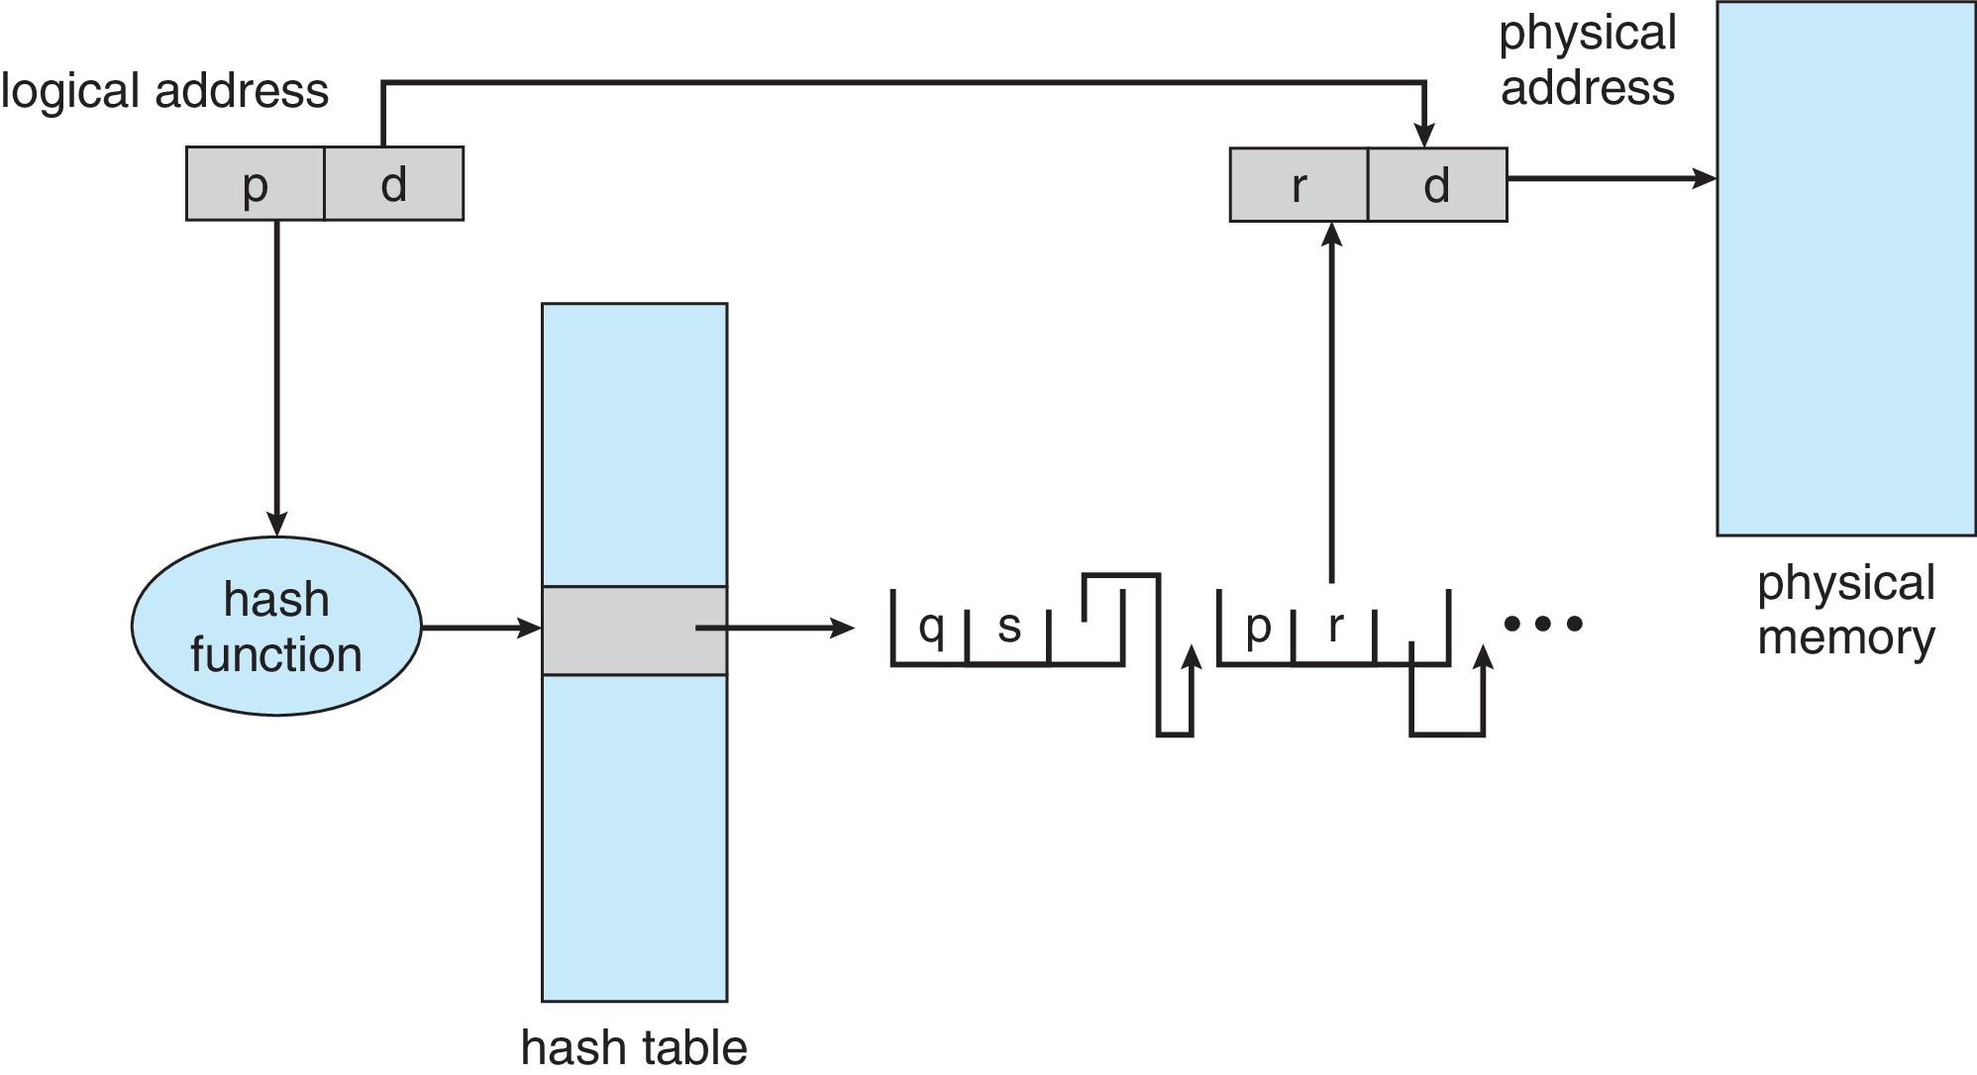
Structure of Page Table
Hashed Page Table:

Slide 35
Structure of Page Types
Inverted Page table: (Home Task)
Rather than each process having a page table and keeping track of all possible logical pages, track all physical pages
Entry consists of the virtual address of the page stored in that real memory location, with information about the process that owns that page
Decreases memory needed to store each page table, but increases time needed to search the table when a page reference occurs
Use hash table to limit the search to one — or at most a few — page-table entries
TLB can accelerate access

Slide 36
Attendance : Section A
0265
1362
0297
0471
0241
1747
1032
0334
0186

